Slide 1
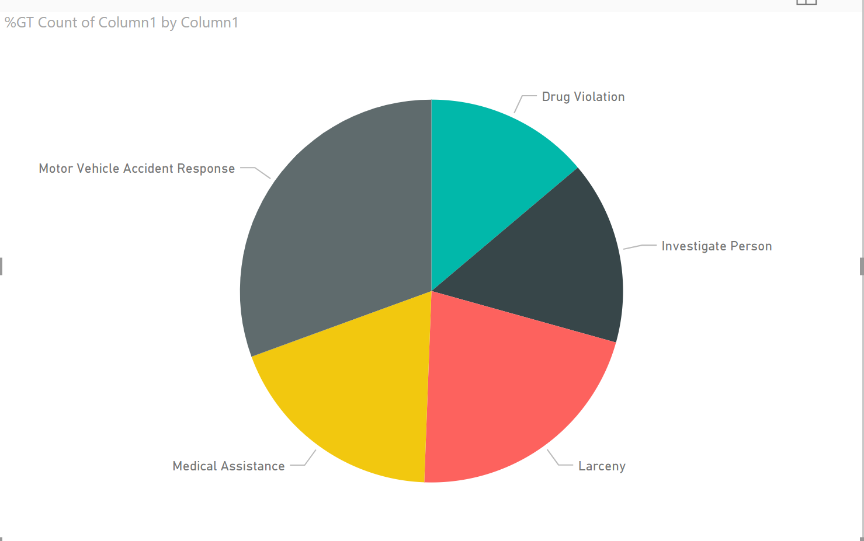
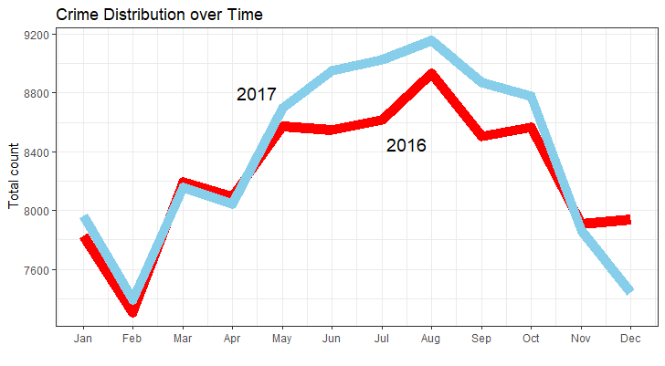
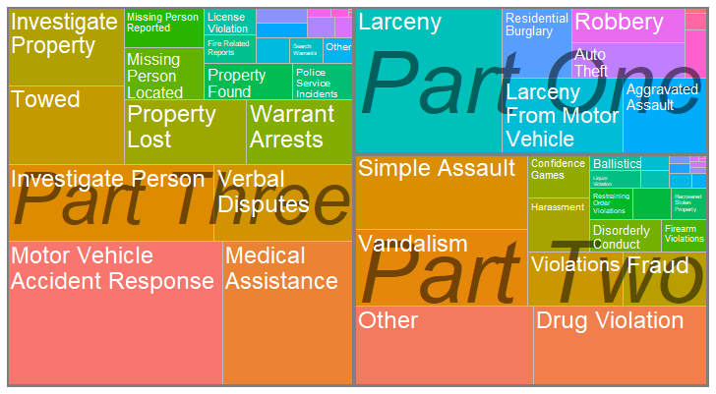
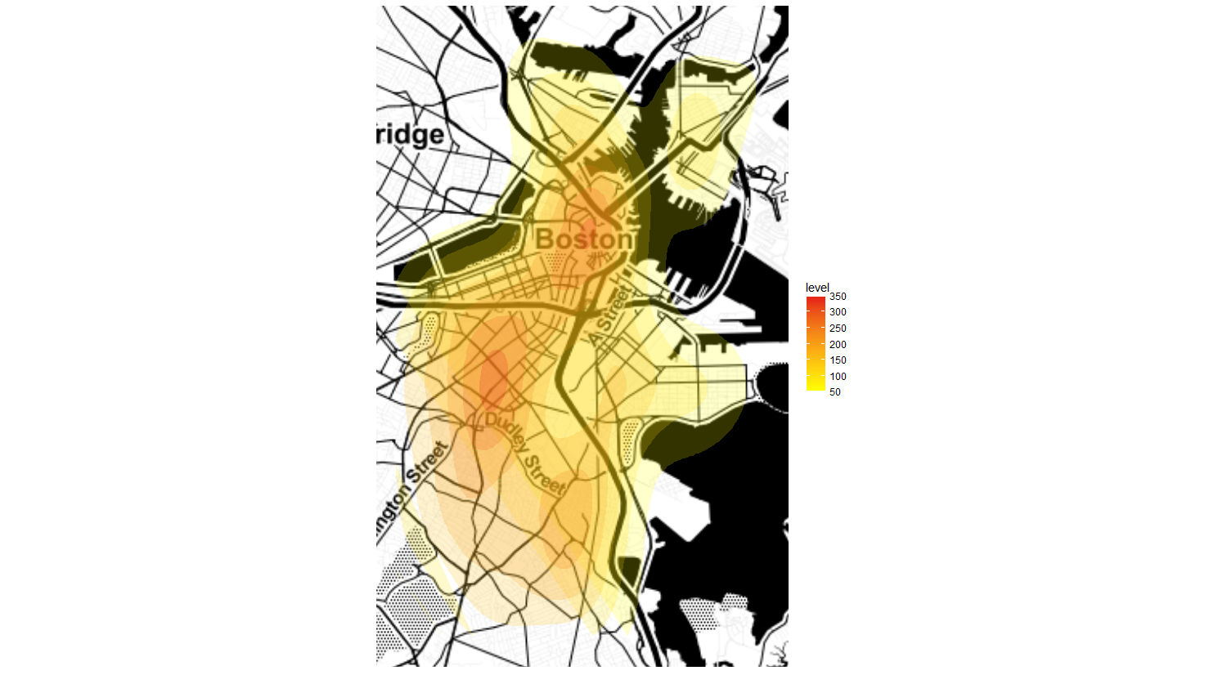
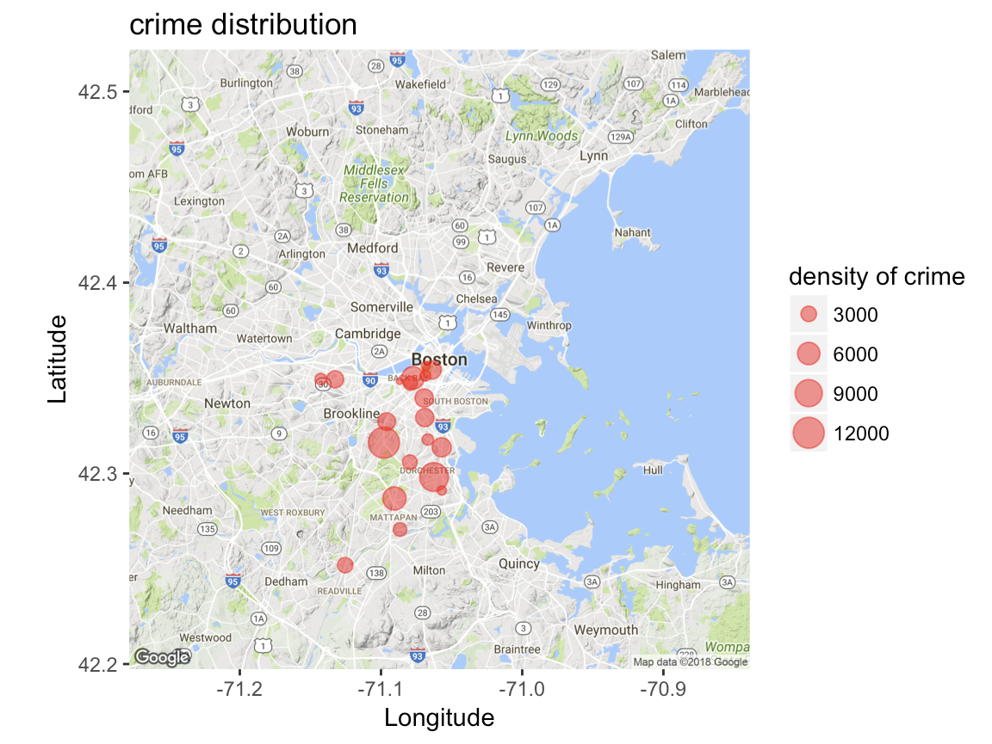
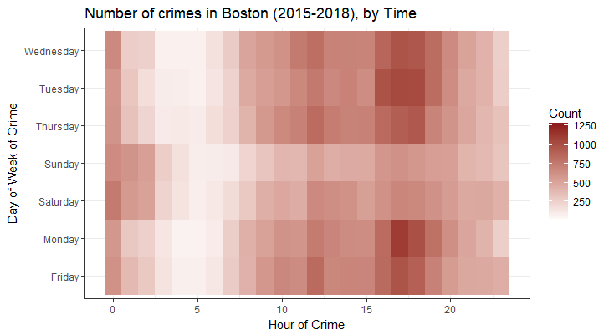

Boston Crime Incident Data Analysis
Team: Tejas Bawaskar, Sagar Ghiya, Lakshmi Manaswitha, Kamala Nayana
Problem Statement
Top 5 Crime Category Distribution
Annual Fluctuations Over Time
Boston is one of the most popular cities in United States and one of the biggest hubs for technical startup’s, universities and historic places. This analysis and visualizations aim to help the residents and visitors stay safe. Also helps Boston police to identify the crime hotspots and improve security in menacing areas.
Tools: R and Tableau
Used Boston crime incident reports dataset starting from June 2015 till date. The set of fields in this dataset focuses on capturing the type of incident, when and where the incident occurred in Boston.
30.57%
Motor Vehicle Accident AccidentResponse
13.48%
Drug Violation
15.47% Investigate Person
About the Data
21.27%
Larceny
18.83% Medical Assistance
Mapping Crime Density
UCR Index Crime Rate
Mapping Top 20 Menacing Areas
This illustration helps to view the crime density in and around Boston.
This is a tree map used to display the crime incident reports hierarchical data.
Used UCR (Universal Crime Reporting) part numbers 1, 2, 3 as the variables that describes the area of titles.
In this map the color and size depicts the number of crime incident reports of a particular UCR part number.
Find the crime hotspots in Boston
This data visualization helps in identifying the top 20 dangerous locations. This map is generated by considering number of crime incident reports at a particular location. Ranking of these places can be given by density of crime.
Crime Distribution by Day and Time
WHEN Does CRIME HAPPEN?
This data visualizations is a heat map of day-of-week and time-of-day. We can find on which day at what time crime rate is more in Boston; can also compare that with other time slots at a glance.
This requires the Hour and Day-of-Week to be present in separate columns.
Spring 2018 Data Visualization Hackathon

